Slide 1
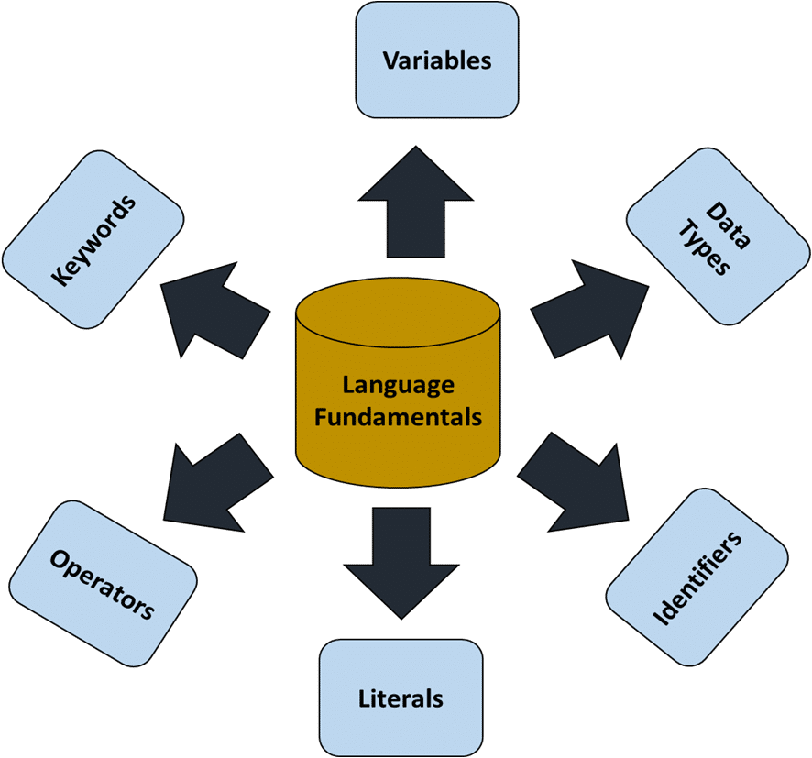
M01 L02
Language Fundamentals
teAch Bedeus LLC debmh.teach@gmail.com is licensed under a https://creativecommons.org/licenses/by-nc-sa/4.0/

Slide 2
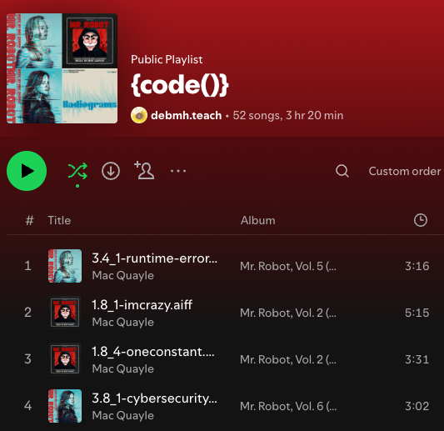
Check In
Introduce yourselves. What music do you like to listen too when you are coding?
Did you set up your environment?
Do you have any questions?
Mandatory Participation Policy What must you do?
Did you complete Survey?
Did you miss a class?
What office hours can you attend?
Set up
Go to canvas and Go to the google drive resources
Open this lecture in your browser you can download or make a copy
Open you Ge01 Document and go to canvas class participation to submit your work for Part 0 Learning and Collaborating Reflection- YOu do not have to have part 0.3 completed but complete that before entire GE01 is due.
Create a copy if you use google drive or download into repo techdocs folder if you use word Tech Doc CS1050.docx
If you email me include the course number CS1050 in the title to help me know what class. I prefer email over canvas messages.
When you put your name on your paper to turn in include last name.
Notes:
Include full name and last name in assignment. Assignments are to be submitted in class, sometimes will mention a codeword so that grader can differentiate between in class and out of class submissions. Out of class submissions need to check in with Deb prior to submission.

Slide 3
Learning and Collaborating Reflection
Share
One of the skills that you think is a strength you bring to a team
A strategy you will use this semester to help you learn
A skill you risk losing if you depend on AI too much?
Notes:
One strength is active listening, want to use learn-to-teach more often. Risk development of critical thinking. Icebreaker: type of music to listen to.

Slide 4
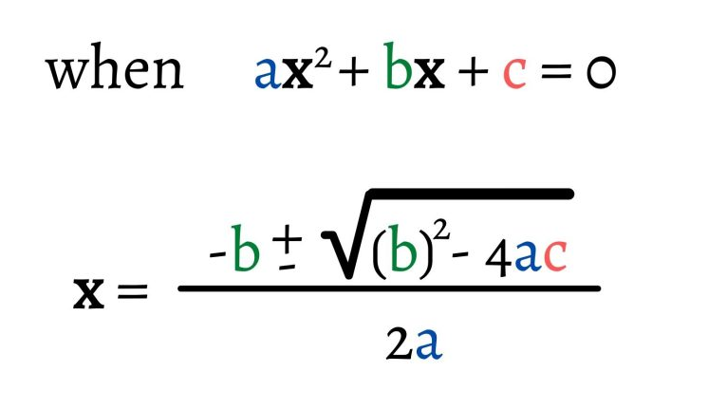
Goals
Variables, Constants, and Data Types
Explain and apply in code the concepts of variables, constants, primitive data types, declared, initialize, assignment
Apply best practices industry convention for naming variables, constants, methods and classes
Arithmetic Operators and Combined Assignment Operators
Identify arithmetic operators
Communication and Collaboration
Discuss
Have you seen this before?
What do you call the letters?
What order are the calculations done?
What might be a better way to name a, b, c, x?
How could this be calculated in a computer program?
Notes:
Variables= thinking of math

Slide 5
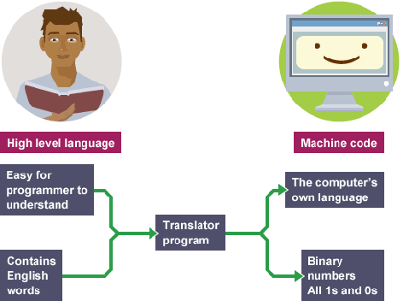
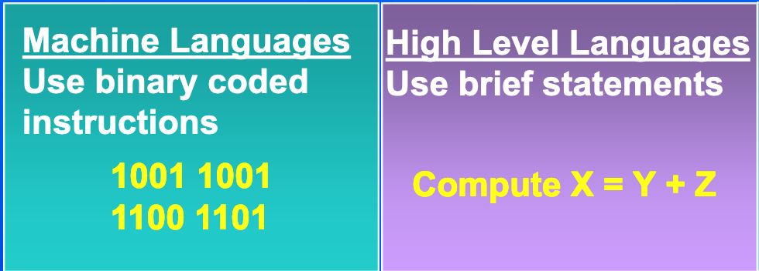
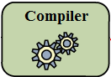
Programming Languages
A program written in a high-level language is called a source program or source code. Because a computer cannot understand a source program, a source program must be translated into machine code for execution. The translation can be done using another programming tool called an interpreter or a compiler.
Machine languages - consist of strings of numbers (ultimately reduced to 1s and 0s) that instruct computers to perform their most elementary operations one at a time.
Assembly languages - Uses English-like abbreviations to represent elementary operations
High-level languages - uses single statements that are English such as Java, Python, C and more.

Slide 6
Java High Level Language and Object Oriented
Developed by Sun Microsystems
Designed in 1991 for use in embedded chips – called Oak
Redesigned in 1995 for developing Web applications – renamed Java
Today Java is used in all sorts of applications
Standalone applications
Mobile applications
Web applications
Full featured development language
Is Java Outdated? - while we will be using Java the goal is to understand the fundamentals of programming and object-oriented languages that can be applied to other languages.

Slide 7
Programming Language Elements
What would help you learn these concepts? How will you remember the information?
Key Words (Reserved Words): A keyword is a reserved word in a programming language that has a predefined meaning and cannot be used for any other purpose, such as naming variables or functions. Keywords form the basic building blocks of a program’s syntax.
Syntax: Computing rules that state how words and phrases must be used in a computer language.
Punctuation: Most programming languages require the use of punctuation characters. These characters serve specific purposes, such as marking the beginning or ending of a statement.
Operators: Symbols or keywords that perform operations on variables and values, such as arithmetic calculations, logical comparisons, and bitwise manipulations. They are essential for creating expressions and controlling the flow of a program.
Identifiers: Unlike key words, which are part of the programming language, these are words or names that are defined by the programmer. They are used to identify storage locations in memory and parts of the program that are created by the programmer. Programmer-defined names are often called identifiers.
Statements: Instructions that perform actions, such as declaring variables, assigning values, or controlling the flow of execution.

Slide 8


Java Program
Go through each line
What do you think this program is doing?
What statements are similar to English?
What are these characters {} ; ()
What color do you think are keywords?
What color do you think are identifiers?
What is a variable? A constant?
import java.util.Scanner;
public class GuessNumber{
public static void main(String[] args){
final int RANDOM_MULTIPLIER = 100;
int number = (int) (Math.random() * RANDOM_MULTIPLIER) + 1;
Scanner keyboardInput = new Scanner(System.in);
System.out.println("Guess a magic number between 0 and 100");
int guess = -1;
while (guess != number){
System.out.print("\nEnter your guess: ");
guess = keyboardInput.nextInt();
if (guess == number){
System.out.println("Yes, the number is " + number);
}else if (guess > number){
System.out.println("Your guess is too high");
}else }
System.out.println("Your guess is too low");
}
}//end of main
}//end of class
Think about what you understand in this java code example. Write down at least three ideas you have about the code on your paper.
Share with your group where each person shares one idea and then rotate to the next person. If you have a experience programming don’t share all you know.
Notes:
What is the program doing?
The program is holding a random number between 1-100, you then input a number, if you do not type in a number, the program will continue to print “guess a magic number…” until you enter a number. Depending on the value of your entry, it will produce three responses.
Final-> example of a constant
Keywords-> purple/magenta -> why we use an IDE, color coordinates items
Text-> color-coded blue
{} and () ->organize your code
Each code will have a starting class and an ending class
Identifiers->lighter purple/brown/maroon
Variable examples: guess (data type: integer)
Class name - FancyCars
Methods - driveOnlyOnSunday()
Variables – numberCylinders: in, out
constant - MAX_STUDENTS, RANDOM_MULTIPLIER

Slide 9
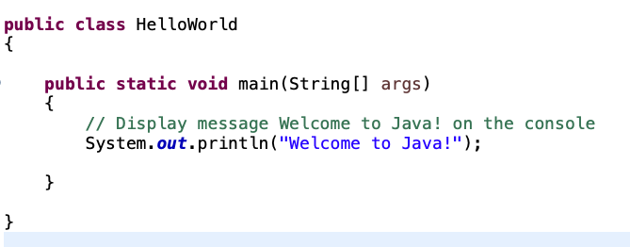
Parts of Java Program
Class name
Main method
Every Java program is written as a class. Each class has a name. In this example, the class name is HelloWorld.
In order to run a class, the class must contain a method named main. The program starts executing statements from the main method.
public, class, static, void are keywords
Comment
Method
Click Hello World Animation
A pair of Curly brackets {} group multiple statements into a single block. See where class HelloWorld starts and stops and main method starts and stops. Notice main method is inside the class and is indented to make it easier to read.
A statement represents an action or a sequence of actions. Statements in Java ends with a semicolon ;
println is a method that is provided in the Java language to display information to the console. The String “Welcome to Java!” inside the parenthesis is the message sent for the method to print.
Comments are text notes in your code that the computer doesn’t run to help you and others understand what the code does.
Notes:
When you create a class, has one public class in eclipse
Class names should always start with a capital letter.
Class name and file name MUST MATCH
Check that you want a public main method (might not say public)
Programs will run from the main method
Braces all line up on the left side, will learn soon how to have Eclipse do it for us, can also indent for us

Slide 10
Identifiers
An identifier is basically a name chosen by the programmer to name Classes, Methods, Variables, Constants
Identifiers follow certain rules
Consists of letters, digits, underscores (_), and dollar signs ($)
Must start with a letter, an underscore, or a dollar sign
Can be any length
Cannot be a reserved word
Cannot be the words true, false, null (these are literal values)
Valid
sum
numberOfStudents
Java is case sensitive so sum, Sum, and SUM are 3 different identifiers
Invalid
7_students
#OfStudents

Slide 11
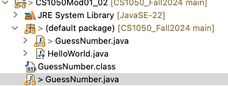
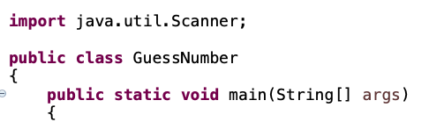
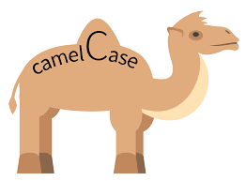
Class Identifier and Main Method
Every Java program must have at least one class. Each class has a name. By convention, class names start with an uppercase letter. In this example, the class name is .
Next the main method is defined to perform the actions. In order to run a class, the class must contain a method named main. The program is executed from the main method.
File name must match class name.
Notice the identifier for the class starts with capital letter, is meaningful and uses camel case

Slide 12
Comments
Comment examples
// is used to start a comment
/* Multi line comments are good before the class code
Here you will explain what the program is doing*/
Add comments to your code to explain the concepts
//declare variables will allocate memory based on data type.
double radius;
Add comment to your ending braces makes it easier to know where each block ends
}//end of main
}//end of class
Accidently deleting an ending brace can cause the program not to run.
Remember every starting { must have and end }
Notes:
Include vocabulary in code (data types and definitions)
Faster to comment on code and copy and paste examples into your tech document and add more comments when needed. Saying what you are learning.

Slide 13
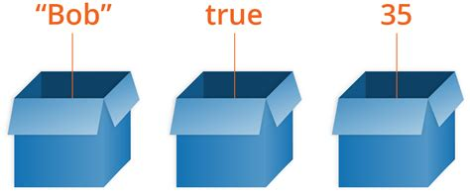
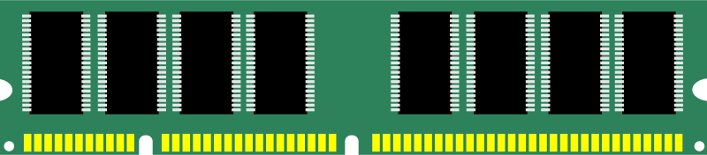
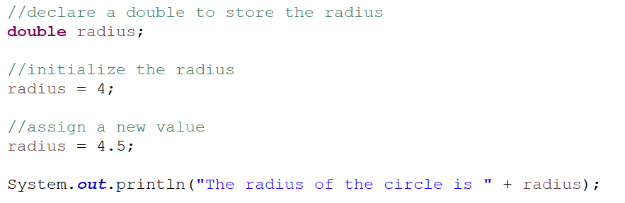
Variables
Variables are used to store a value that may change (vary)
Have a data type such as String, boolean, integer, char, double
Are stored in computer memory
In the code
Declare identifier and data type
Initialize by assigning a value in memory
Assign a new value in memory
Read the value from memory
String
boolean
integer
Use identifier name to access memory location to store and retrieve information
radius
4
009AFD30
Declare radius to hold a double will create a location in memory to with enough bytes to store a double. The memory location identifier of the variable is radius
Initialize to a value by assign the value 4. Will be stored as a double 4.0 in the memory location identified by radius.
Assign a new value in memory 4.5. This removes 4 and replaces with 4.5
Get the current value 4.5 from radius memory location
Notes:
Double=-> floating points, can store information smaller than an integer
Integer-> no decimals
Declare your item, then can call item later
=-> assign
Variable on left-> assigning something to is
Don’t see on left, getting something out of it.

Slide 14
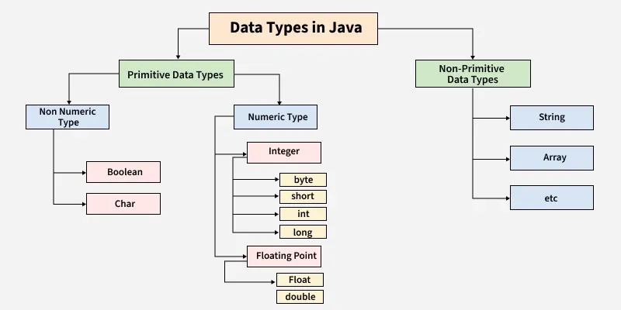
Data Type
Java is a statically-typed language, meaning every variable must be declared with a data type. These data types determine:
The kind of values a variable can hold
How much memory it uses
What operations can be performed on it
Java data types are broadly categorized into two types:
Primitive Data Types
Non-Primitive Data Types (Reference types)
If you have programmed in Python you didn’t need to declare variables with a data type.
We will focus on primitive data types first.
Java Data Types - GeeksforGeeks

Slide 15

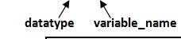
Data Types Ranges and Storage Size
When declaring a variable for a primitive data type enough memory is allocated based on the data type.
We will be using int, double, char and boolean.
Allocates 8 bytes
Data Type | Description | Size (memory allocated in bits) | Example
byte | Smallest integer type | 1 byte (8-bit) | byte age = 25;
short | Small integer | 2 bytes (16-bit) | short year = 2025;
int | Default integer type | 4 bytes (32-bit) | int population = 1000000;
long | Large integers | 8 bytes (64-bit) | long distance = 15000000000L;
float | Single-precision decimal | 4 bytes | float grade = 89.5f;
double | Double-precision decimal (default for decimals) | 8 bytes | double pi = 3.14159;
char | Single character (Unicode) | 2 bytes | char grade = 'A';
boolean | True or false | 1 bit (typically 1 byte used) | boolean passed = true;
Notes:
Highlighted in green= what we will use

Slide 16
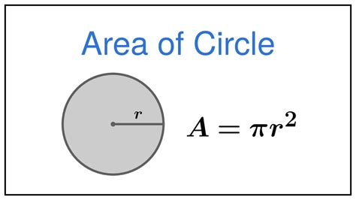
Quality Code: Variable Naming Conventions
Create meaningful identifiers for variables
Use meaningful names
Do not use one letter variable names
Begin with lowercase
Multiple-word identifiers use camel case
First word starts with lowercase letter
Each remaining word starts with upper case
What if I needed to create an identifier for a variable to hold the total number of students?
n | bad
NUMBER | bad
count | A little better
students | A little better
totalStudents | best
For this class
Unlike math class 1 letter variable names should not be used.
Notes:
Use green. BEGIN LOWERCASE (camel case)

Slide 17

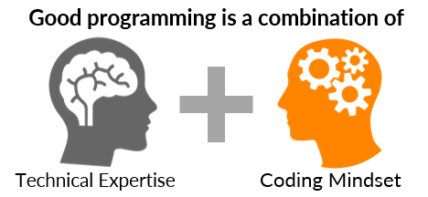
Quality Coding Guide Using Industry Standards
Read Code Conventions for the Java Programming Language: 1. Introduction
We will follow the following when implementing code
Naming Conventions - Java
Class name - FancyCars
Methods - driveOnlyOnSunday()
Variables - numberCylinders
constant - MAX_STUDENTS
One constant or variable declaration per line since it encourages commenting and Put constant and variable declarations at the beginning of method blocks and initialize.
// Constants for grade weights
final double CLASS_PART_PERCENT = .15;
final double GUIDE_EXPL_PERCENT = .2;
// Initialize Variables to hold possible grade for each category
double guideExpl = 0;
double classPart = 0;

Slide 18
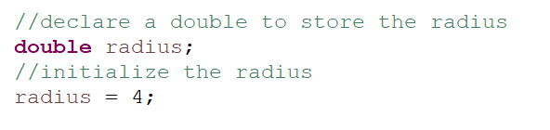
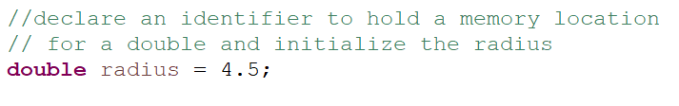
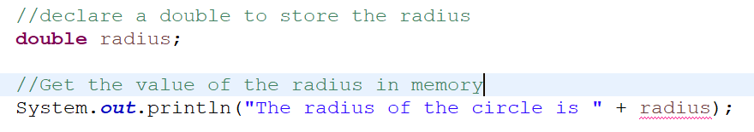
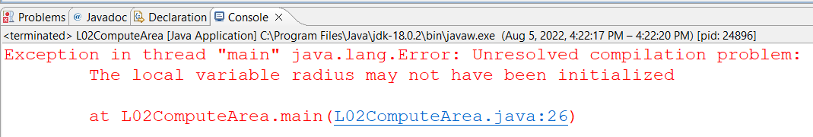
Declare and Initialize Variables
Declare variables by defining what data type.
Initializing a variable means to assign an initial value to it
You can declare and initialize in one step
Always initialize before using
The = symbol means assign (not equal to). Read as radius is assigned 4.5. This is assigning that value to the memory location identified by radius.
Error: A variable that is declared but not initialized does not have a defined value, hence it cannot be used until it is assigned a value.
Notes:
Declaring vs initializing
Declaring-> create memory location
Declaration happens once
Initializing-> assigning an initial value
Always assign an initial value

Slide 19
Constants
Constants are used to store a value that will not be changed when the program runs. Constants can be beneficial so information is not hardcoded in the program. More on this later.
Declare and initialize using final keyword with name and data type
Enough memory will be allocated for that data type but it will be read only memory
Naming conventions:
Using meaningful names
Use all uppercase
Words separated with underscore
final int RANDOM_MULTIPLIER = 100;
Notes:
Whatever you assign it, it will not change while the program is running.

Slide 20
Number Literals
A literal is a fixed value that appears directly in your code. When you type 10, 3.14, “Hello” in a program, you're using a number literal.
The = means assign what is on the right and store in memory identified by name on the left
Java allows scientific notation for large/small decimal numbers (e.g., 1.5e6 = 1,500,000), but we won’t need it for this course.
type identifier assignment literal
int years = 15;
final double PI = 3.14;
double rate = .05;

Slide 21
Print Methods
The method println prints value followed by a new line.
The method printing prints value without going to a new line
System.out.println("Hi there!");
prints out the string between the first " and the second " followed by a new line. The "Hi there!" is called a string literal.
System.out.println("The area for the circle of radius " + radius + " is " + area);
Print the string literal and adds on after (+ radius) the value of the radius currently in memory, followed by string “ is “ and adds on value assigned to area.
Notes:
Printing out to the console
How to print to the console
System-> class provided by java to go out
System.in for scanner, system in is the keyboard, default system out is the console.

Slide 22
Discuss
How can you learn these terms and concepts?
Terms: keyword, class, identifier, method, variable, constants, declare, memory, assign, initialize, literals, data type, primitive data type, naming conventions, comments
Your group will discuss the code.
Rotate in your group to share one term to explain something in the code.
Go to ComputeArea example. Run animation to see if you are understanding the different parts.
public class ComputeArea {
public static void main(String[] args) {
//declare and initialize constant in read only
final double PI = 3.14159;
double radius;
double area;
radius = 20;
area = radius * radius * PI;
System.out.println("The area for the circle of radius " +
radius + " is " + area);
}//end of main
}//end of class
Do not worry if you don’t fully understand. Remember learning is making mistakes and receiving feedback to improve. Feel free to go back to previous slides.
Notes:
Public class: calls class ComputeArea

Slide 23
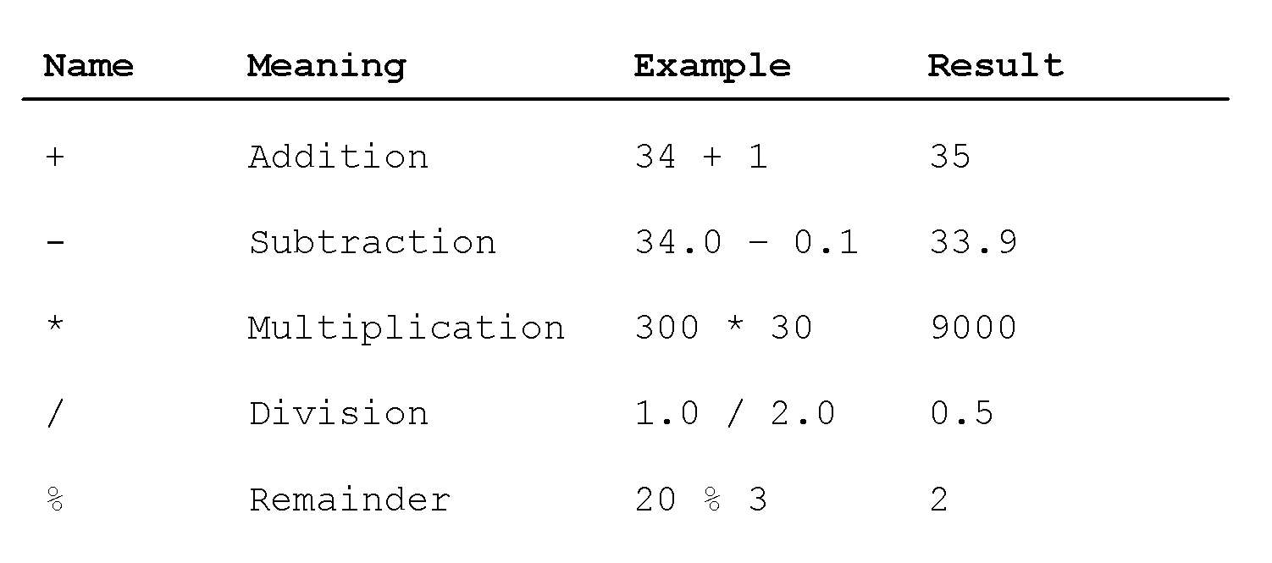
Operators and Evaluating Expressions
Recall from math the order of operators:
Anything in parentheses
Exponents (powers, square roots, and so on)
* / % (multiplication, division, remainder from left to right)
+ - (addition, subtraction from left to right)

Slide 24
Integer Division and Modulo Operator
Division with integers – be careful!
Result is an integer
Fraction part is truncated
Examples
½ is 0
17/5 is 3
Remainder (Modulo) operator %
5 % 3 yields 2(the remainder of the division)
You can use this property to determine whether a number is even or odd.
an even number % 2 is always 0
an odd number % 2 is always 1
Here are some examples of using Modular Arithmetic
Java assumes that if you are doing division with integers that you want an integer result and it will truncate and throw away the part after the decimal point.
Discuss the code and then step through animation ComputeChange
Notes:
Integer division return integers. It rounds to an integer. Truncated-> drops it off the final value
DO NOT ROUND UP OR DOWN
Modulo=remainder

Slide 25
Exponent Operations
final double PI = 3.14;
double radius = 2;
System.out.println(Math.pow(2, 3));
// Displays 8.0
System.out.println(Math.pow(4, 0.5));
// Displays 2.0
System.out.println(Math.pow(2.5, 2));
// Displays 6.25
System.out.println(Math.pow(2.5, -2));
// Displays 0.16
System.out.println( PI * Math.pow(radius, 2));
// Displays 12.56
To raise to a power a^b use the following method
Math.pow(a, b)
You will learn more about using Math methods in module 2.
Notes:
Power is a method, cant just raise it like you can in Rstudio

Slide 26
Technical Developer Documentation
Developer documentation helps people understand how a technologies work so you can build, use, or improve it.
Writing things down helps you keep track of how different technologies and tools were used — so you don’t forget later.
Makes it easier for someone new to understand the project and start working on it faster.
Sets clear rules and examples so everyone writes code the same way and reduces errors.
Good docs make it easier for others to use and build on your work.
When the answers are in the docs, people can help themselves.
Have you ever used websites, documentation or videos to help you learn or build something?
Do you have information from a previous class to help you when you can’t remember how to do something or what the terms mean?
Have you ever documented information to learn something and use in the future?
Notes:
To work on, difference between variables, other definitions feel easier to identify besides differentiation rom characters and variables.

Slide 27
Best Practices for Developer Documentation
How to Improve Developer Documentation? | Archbee Blog
Be Concise by providing clear and simple explanations
Use short sentences, small paragraphs
Use lists and tables to organize information
Use standard industry terms but explain in simple language
Use Code Snippets and Visuals to reduce lengthy explanations:
Include examples you explored or created
Include comments to describe parts of code
Include Screenshots such as from your debugger
Include Resources that give steps or help explain concepts
Include website link with summary
Include links to videos with summary of content
If you haven’t downloaded the Technical Document Template for GE M01 yet download it or make a copy in google drive Tech Doc CS1050. You will be adding your information during each module and turn in with your GE M01.
If you explain in your own words, use code from labs, book or that you write, screenshots from debugger, your own drawings you can print out your technical document to bring to the quizzes.

Slide 28

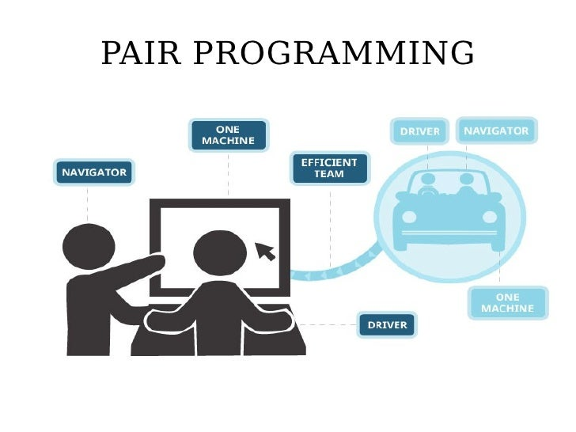
Pair Programming
What is Pair Programming?
Pair programming is a collaborative effort that involves a lot of communication. The idea is to have the driver and navigator communicate, discuss approaches and solve issues that might be difficult for a single developer to detect.
Setup:
One shared computer, alternate roles
Driver: Enters code
Navigator: checks the code being written
Effects:
Build collaboration skills
Fewer mistakes
Knowledge is shared to build understanding
It can be used in industry but i doesn’t mean every company uses it or it is used by a company all the time. It is best in specific situations.
Notes:
Going to insert concise information and definitions and examples into your tech document
Going to work together
- put items into code to save time on updating to tech doc?
Pair programming, use one computer. One computer, different roles

Slide 29
Lab: Pair Programming
Humans write algorithms to solve tasks and use programming languages to tell the computer how to execute the algorithm.
Go to ComputeArea example and copy the code
Go to Visualize Code select java from the drop down.
Paste your code and click visualization.
Add the following code below println method
Declare integer, identifier test, initialized to 20
Declare double, identifier divResult where is assigned divResult = test/3
Add statement to print divResult
Visualize code
Add another statement divResult = radius/3
Add another statement to print divResult
Visualize code
public class ComputeArea {
public static void main(String[] args) {
double radius; // Declare radius
double area; // Declare area
// Assign a radius
radius = 20;
// Compute area
area = radius * radius * 3.14159;
// Display results
System.out.println("The area for the circle of radius " +
radius + " is " + area);
}
}

Slide 30
Next Steps
Go to preparation in canvas
Explore information and activities from this lecture and the following book sections 1. Getting Started and Primitive Types — CS Java: sections 1.2 - 1.4
Update your technical documentation to explain in your own words and code examples you explore from lecture or book. Use headings to organize information on these Module 1: Programming Fundamentals and Tools objectives
Declaring, initializing, and assigning variables.
Compare constants and variables
Order of operations, integer division and the modulus operator.

